Slide 1
IDS 789: Finance Business Models
FALL 2025
TECHNICAL PROJECT
Buy-Now-Pay-Later: A Risk Management Perspective
Haiwei Du
Tony Ngari
Aaron Jiang
Turner McLaurin

Slide 2
Content
Introduction
Methodology
Risk Analysis
Simulation
Insights
Conclusion

Slide 3
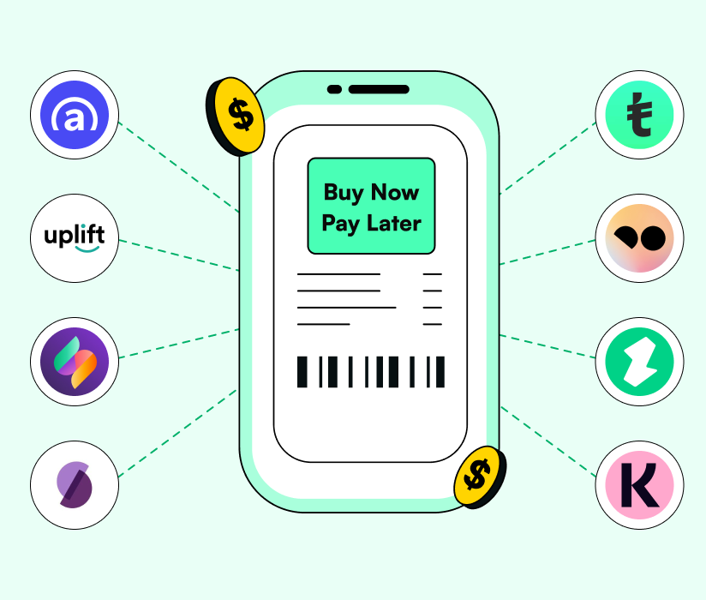
Introduction
What is Buy-Now-Pay-Later (BNPL)?
A short-term installment credit product.
Consumers split payments into multiple interest-free installments
Requires minimal onboarding
Positioned as a frictionless alternative to traditional credit

Slide 4



Market Landscape
BNPL sector grew rapidly during covid, especially among young people and consumers with poor credit scores prohibited them from buying on credit.
  91.5 million users in the United States (Loizos, 2025)
Major players: Affirm, Klarna, Afterpay, and recently PayPal.
  Klarna - $2.8 Billion
  Affirm - $2.3 Billion
  Afterpay - $1.3 Billion (FY 2024)
Notes:
Market landscape - touch on state of the market, why people are turning to BNPL, the numbers they’re doing, and their use cases.
Buy now, pay later apps made $12.5 billion revenue in 2024, a 10.6% increase on the previous year
Klarna made $2.8 billion in 2024, the most of any BNPL app
Klarna has about 35% global market share in the BNPL market
BNPL apps had 365 million users in 2024, a 9.2% increase on 2023
There were 156 million BNPL app downloads in 2024, an improvement of 20 million

Slide 5
Problem & Objective
BNPL lenders operate with limited visibility, while pushing through instant, frictionless loan approvals
  63% of users have taken out multiple loans at once, oftentimes across several BNPL lenders.
The industry is very susceptible to macroeconomic shocks.
  25% of users have used BNPL services to buy groceries
  20% of holiday shoppers this year plan to use BNPL to finance their purchases
Objective: Determine if there is a bubble.

Slide 6
Methodology
To understand how exposed BNPL companies are to risk, we do the following:
Build a credit-risk modeling pipeline, where we use a large anonymized BNPL-style loan dataset to estimate probability of default (PD).
Simulate BNPL company financial performance to test the resilience of the business model

Slide 7

Risk Modeling Pipeline
Data → Preprocessing → EDA → Modeling → Results
Data – Data Source, Data Set, Target Variable, Dependent Variable, Data Cleaning.
Preprocessing – Cleaned and renamed fields, check variable types, handled missing values, Feature Selection.
EDA – Plots and basic information to find the outline of the data set and default drivers in affordability, timing, and size.
Modeling – Standardize, Train Test Split, with all different models.
Results – Model performance with plots that shows the .

Slide 8

Data
Dataset: 160K anonymized “pay later” loans from a digital lender (Kaggle Paylater Loan Data)
Variables: 28 fields – income, basic borrower info, loan amount, interest rate, term, repayment dates, etc.
Target: Binary default flag — whether the loan ever entered default (1 = default, 0 = no default)
Cleaning:
Renamed columns to clear labels (income, amount, interest_rate, term_months, income_verified, settle_days)
Converted core numeric fields (amount, rate, term, income, existing affordability ratio, max prior amount, default, settlement timing) to numeric
Dropped loans missing any of these critical fields
Standardized all binary flags (income_verified, first_payment_default, default_flag) to 0/1

Slide 9

Risk Model: Feature Selection
Step 1 – Focused variable set
  Kept only variables tied to credit risk and affordability
  Core loan terms: amount, term, interest rate
  Borrower side: income, income_verified, simple demographics, basic borrowing history
  Repayment burden: existing affordability ratio, payment-style measures
Step 2 – “Signal” check for numeric features
  For each numeric variable, computed a Kolmogorov–Smirnov (KS) statistic
  Dropped variables with weak KS or many missing values
  Treated high-KS variables as strong numeric drivers
Step 3 – Visual diagnostics
  Correlation heatmap among strong drivers and default
  Default rate by decile (with confidence bands) for each strong driver
  Found clear, stable relationships for:
    settle_days, payment_ratio, loan_income_ratio
    amount, term_months, max_amount_taken
Final feature set
  Strong numeric drivers + engineered features
    e.g., payment-to-income, utilization vs. prior max amount, simple rate × term × amount interactions
  Key categorical indicators (loan purpose, basic borrower characteristics)
  Dropped weak, low-variation, or highly redundant variables

Slide 10

Risk Model: Training
Preprocessing
  Numeric features standardized with z-scores (mean 0, variance 1)
  Categorical features (gender, loan_purpose, residence_status) one-hot encoded
  Built a single ColumnTransformer + Pipeline so the same steps apply in training and testing
Train–test split
  80% training, 20% test
  Stratified by default status to preserve the overall default rate
Models trained
  Logistic Regression
    L2 regularization, class_weight="balanced" to up-weight defaults
  Random Forest
    500 trees, min leaf size = 2, class_weight="balanced_subsample"
    Captures non-linear effects and interactions automatically
  Histogram Gradient Boosting
    Tree-based boosting on binned features
    Designed for high performance on tabular data
Evaluation metrics
  ROC-AUC, Precision–Recall AUC, Brier score
  Calibration curves and lift charts to check probability quality and rank ordering

Slide 11
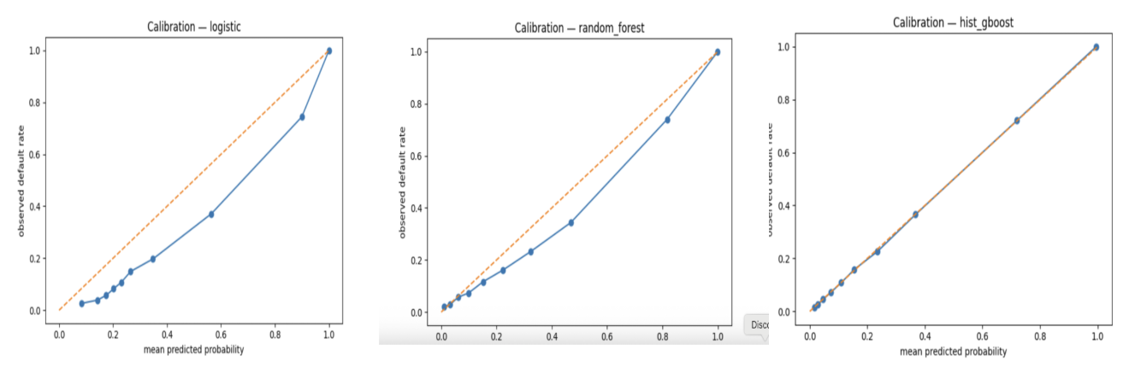
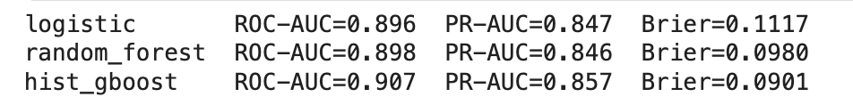
Risk Model: Performance

Slide 12

Risk Model: Performance (2)
All three models clearly beat the simple baseline logistic regression
Histogram Gradient Boosting performs best overall:
ROC-AUC above 0.90 (very strong rank ordering of risk)
Highest Precision–Recall AUC (good at finding defaults in an imbalanced dataset)
Lowest Brier score (most accurate probability estimates)
Calibration plots show predicted PDs line up well with observed default rates, especially in the mid-range
Lift charts: high-score buckets capture a large share of all defaults, confirming strong separation
Takeaway for the story:
Default risk is highly predictable with rich features
The main fragility of BNPL is not weak risk models, but the underlying business economics

Slide 13
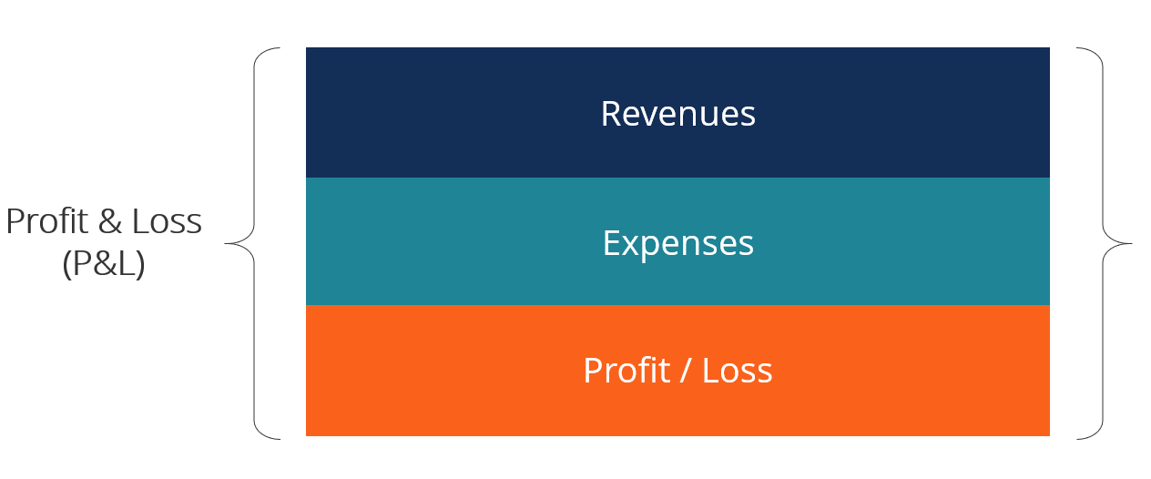
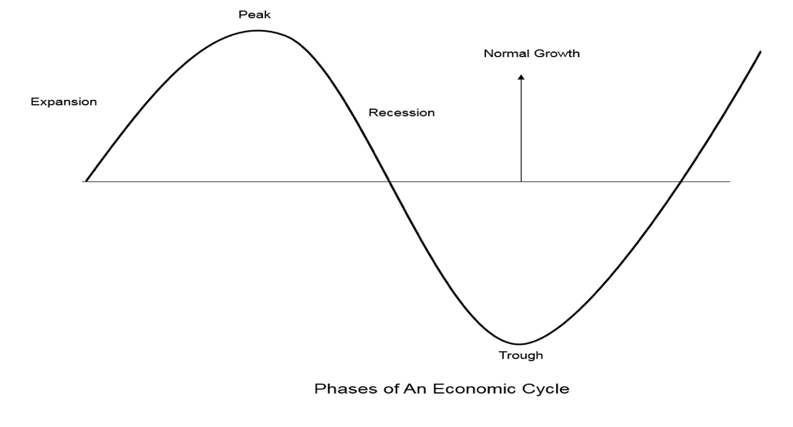
Simulation
Simulated BNPL company financial performance month-by-month over 24 months
Directly modeling all revenue and cost components calibrated to real-world BNPL metrics
Accounted for economic conditions and company scale

Slide 14
Simulation (2)
Business & Cost Structure Parameters
Scale: 6 Levels (10k → 50M users)
Starting Capital: $5M → $2B
Revenue: 3.5% Merchant fee on GMV
Fixed Costs: $0.5M – $5M monthly (tiered by user scale)
Variable Costs: 1.5% of GMV (processing, fraud, support, data)
CAC: $50 → $20 per new user (declines with scale)
Capital Costs: 8–20% annual interest on 80% debt-funded loan book
Scenario | Default Rate | GMV Growth | Recovery Rate | Capital Cost | Historical Period
Baseline | 3.5% | +5% | 40% | 8% | 2019 stable economy
Mild Recession | 5.0% | 0% | 35% | 10% | 2001, 2020 COVID
Severe Recession | 7.5% | -5% | 30% | 15% | 2008-2009 GFC
Boom Times | 2.5% | +15% | 45% | 6% | 2021 stimulus era
Stagflation | 6.0% | -2% | 30% | 18% | 2022-2023 inflation
Rate Shock | 4.0% | +3% | 38% | 20% | 2023 rapid rate hikes
Notes:
*FULL PARAMETERS IN APPENDIX - TOO COMPREHENSIVE TO INCLUDE IN PRESENTATION

Slide 15
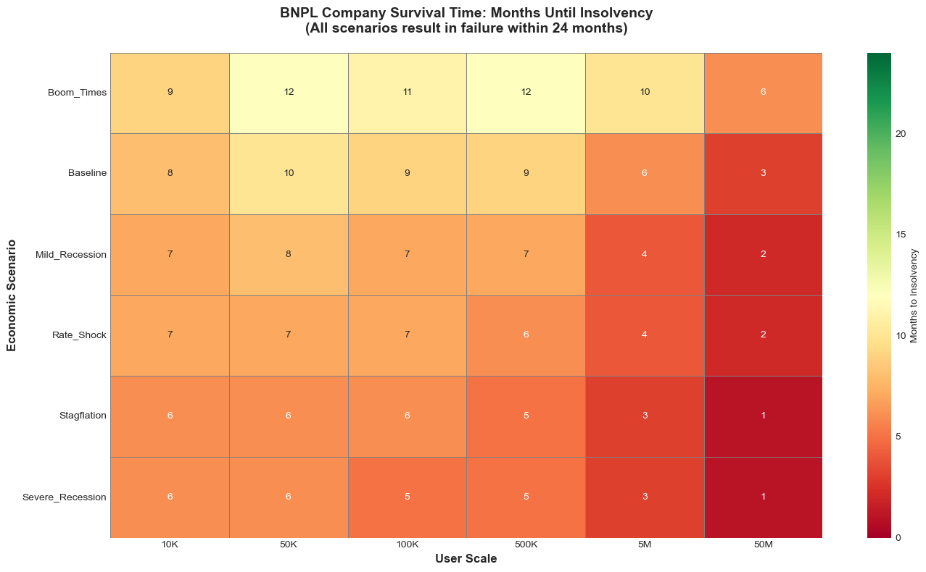

Slide 16
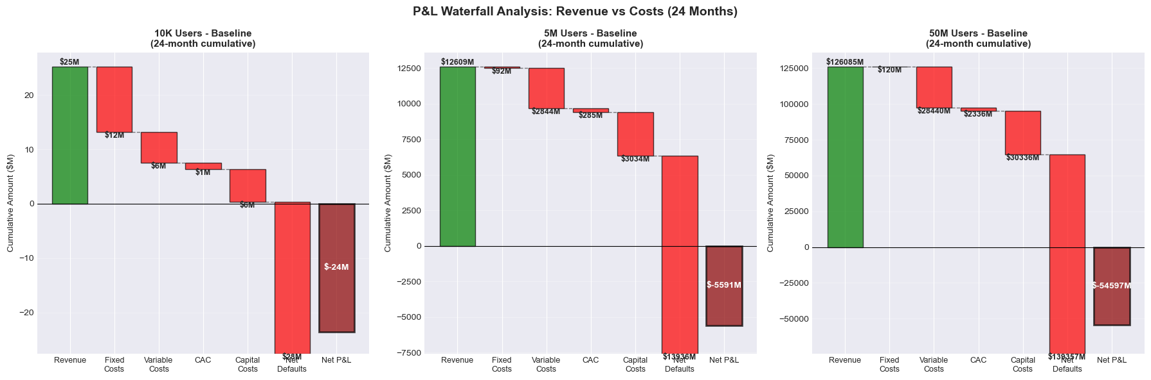

Slide 17
Insights
Our risk models can accurately evaluate risk
  Safe to assume major companies can do so to a superior extent
Across all scenarios, BNPL providers ultimately lose money - either directly through credit losses or indirectly through heavy operating costs.
  Operating costs more impactful at smaller scale
  Credit losses more significant at larger scale
This simulation is a simplification, but strongly reflects real-world performance
 | Klarna | Affirm
Revenue | $2.8B | $2.3B
Profit / as a % of Revenue | +$20M / 0.71% | -$500M / 21.7%
Credit Losses / as a % Revenue | $500M / 17.9% | $680M / 29.6%

Slide 18

Insights (2)
So why would companies continue to operate in this space?
  Potential path to long-term profitability
  Operational gambit - Give up profit to acquire other business advantages e.g. consumer data, payment rails
  BNPL as entry point to pivot into higher margin financial services e.g. advertising, credit cards
  Focus on acquisitions and exits (e.g Afterpay $29Bn sale to Block Inc.)

Slide 19
Conclusion
Risk prediction is not a limiting factor
  Risk can accurately be evaluated, even without extensive credit history
The business model appears to be fundamentally unsustainable
  Extremely sensitive to external economic conditions
  Scale alone doesn’t guarantee profitability
  Operating margins are extremely thin
The “loss-leading” BNPL model may be rational: not sustainable on its own, but viable as a strategic platform for broader fintech ecosystems or future pivots.

Slide 20
NON-TECHNICAL PROJECT
Case Study
Goldman Sachs’ AI Infrastructure Team

Slide 21
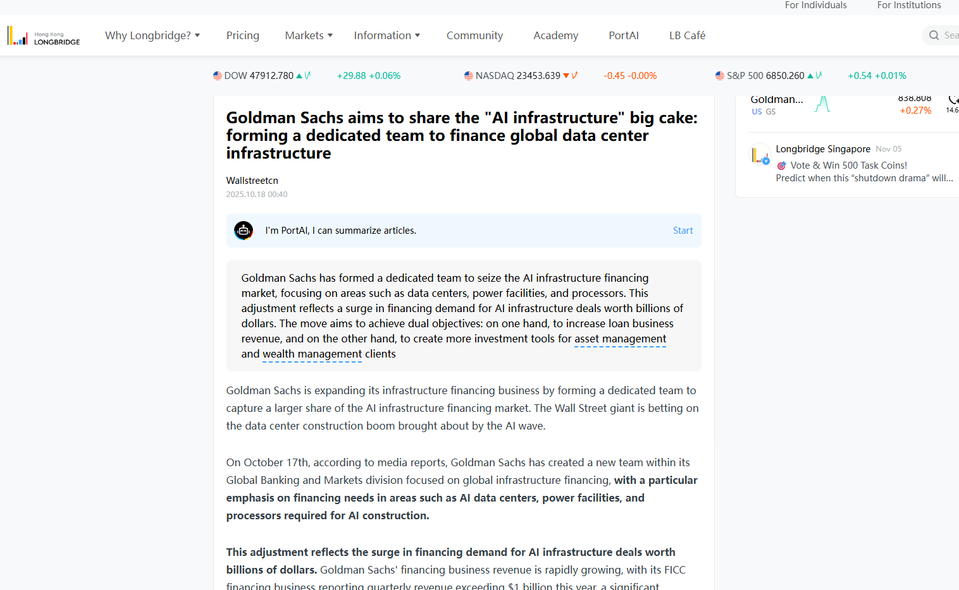
Content

Slide 22
Relevant Skills
Structured Finance & Modeling
Project Finance Modeling: Ability to build complex DCF models for long-term cash flows, specifically for data centers and power facilities.
Debt Structuring: Expertise in designing loan structures (senior/mezzanine debt) and understanding balance sheet retention strategies.
Securitization Knowledge: Skills in packaging debt to sell to insurance companies and the broader securitization market.
Sector-Specific Technical Knowledge
AI Asset Valuation: Understanding the lifecycle, depreciation, and financing needs of AI processors and GPU equipment.
Infrastructure Insights: Deep understanding of physical assets including data center operations, power/energy grids(PPA etc), and renewable energy financing.
Market Analysis: Ability to analyze the surge in government and corporate borrowing demand related to AI and defense spending.

Slide 23
Job Requirements
Educational & Professional Background
Academic Focus: Strong background in Finance, Economics, or Quantitative fields. Engineering/CS backgrounds are increasingly valued for understanding the underlying physical assets.
Certifications: CFA (Chartered Financial Analyst) and SIE (Securities Industry Essentials) are strong indicators of technical proficiency.
Experience & Knowledge Base
Capital Solutions Experience: Experience in private credit, loan arrangement, or alternative capital markets.
Deal Experience: Proven track record in executing billion-dollar scale financing deals or complex infrastructure projects.
Cross-Functional Agility: Ability to work within the "Global Banking and Markets" division, collaborating across FICC and asset management teams.

Slide 24
Career Paths
Infrastructure Private Equity: Transition to top-tier PE firms (e.g., Blackstone, KKR) that are aggressively acquiring data centers and digital infrastructure.
Tech Strategy (Hyperscalers): Strategic finance roles at major tech firms (Google/Microsoft/Amazon) managing capital expenditure for AI infrastructure.
Specialized Investment Funds: Opportunities in funds focused specifically on energy transition and digital assets.

Slide 25
THANK YOU

Slide 26
Work Cited

